Slide 1
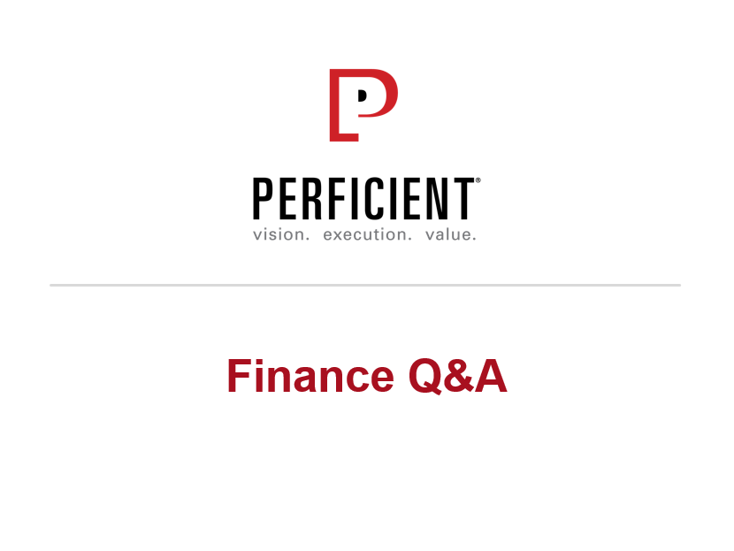

Slide 2
Reimbursement Process
Apply
Submit online to PM
Approve
PM
Payment
Submit hardcopy to Finance: Print Attach original invoices Sign
Finance
Payment Way: Deposit into your BOC’s bank account
Payment Day: Wednesday
Payment Term: PM & Finance’s approve

Slide 3
Reimbursement Process
expense report
Submit Online
PM Disapprove
PM Review
Submit Hardcopy
PM Approve
Payment
Finance Approve
Finance Review
Finance Disapprove
Add new expense report
Notes:
3

Slide 4
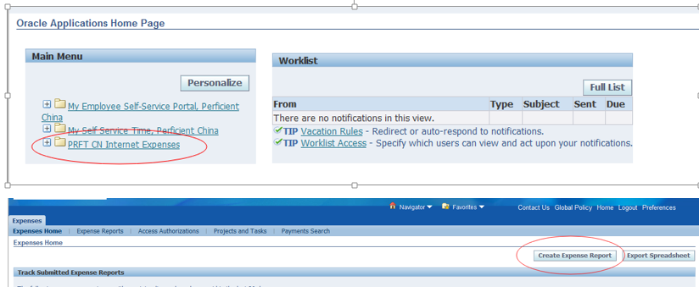
Submit an expense report
Where to start
https://ebs.perficient.com
Notes:
4

Slide 5
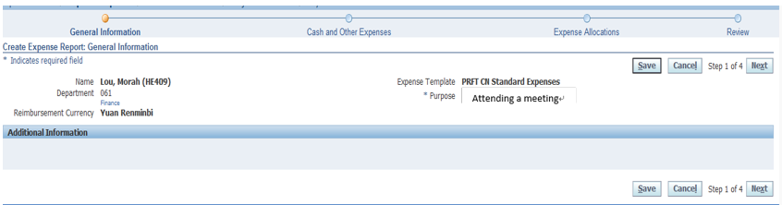
Submit an expense report
Submit your expense report
Make sure each step won’t be missed out when you process the expense submitting!

Slide 6
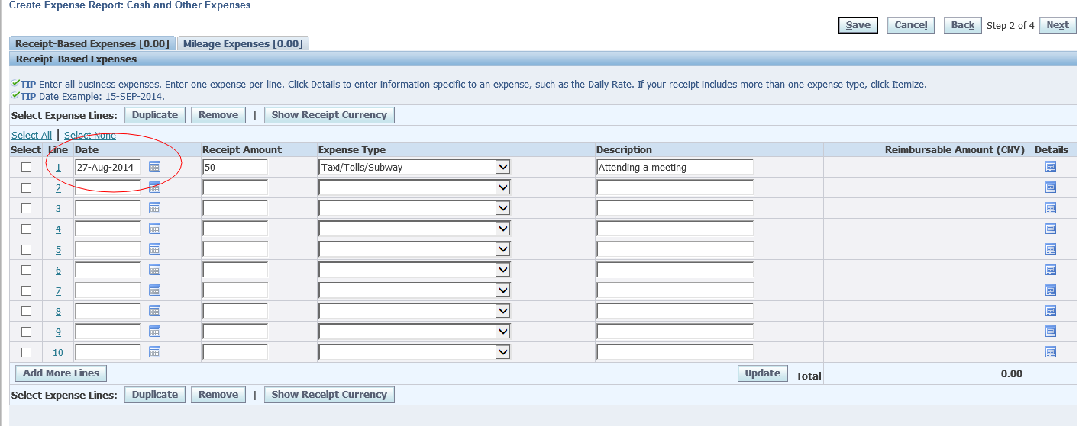
Submit an expense report
Date is supposed to be when expense occurs and the same on the receipt. If you can’t have the receipt right away, mark the time on it.

Slide 7
Submit an expense report
Don’t get confused!
For your first submitting time on EBS, you might reimburse for physical checkup, please pick the day you join us, which is different from others!

Slide 8
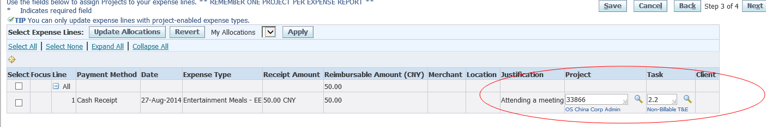
Submit an expense report
Pick the project accordingly, and task matches with expense report.

Slide 9
Submit an expense report
About the project & task
Project:
The code must be the “os chn admin”, except the expense belongs to the project which we need to get the bill back from American.
You need to ask your line manager whether the expense need to get the bill back from American or not , when you encounter such a situation.
Just like going to American on a business trip.

Slide 10
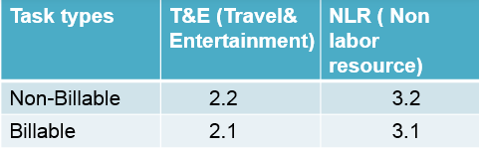
Submit an expense report
Task :
In general,
Just like Taxi/Tolls/Subway physical checkup Entertainment-*****(teambuilding)...
Task number is 2.2
Training-*** IT-*** expense about admin(office-***)
Task number is 3.2
If the expense belongs to the American, you need fill 2.1 or 3.1 correspondingly

Slide 11
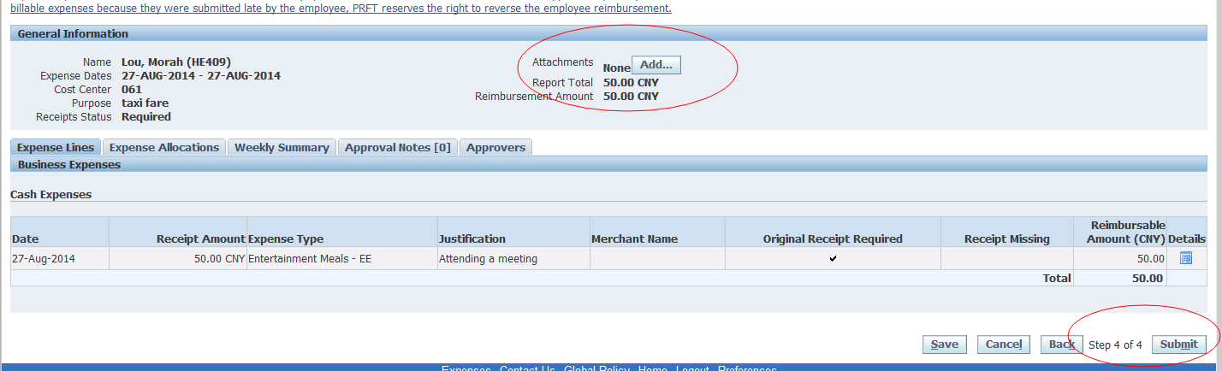
Submit an expense report
Receipt upload

Slide 12
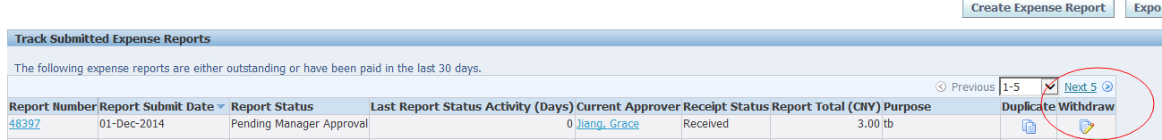
Submit an expense report
Expense update

Slide 13
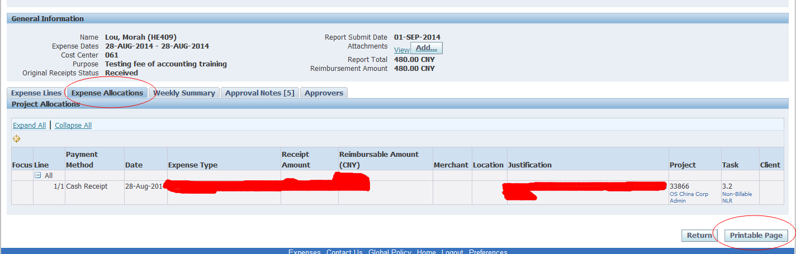
Submit an expense report
Submit to Finance
Print out(Expense Allocation) after submitting and sign your name on it.
Submit expense report with receipt , approval email as well if needed.

Slide 14
How to reimburse Per Diem
Per diem definition
Per diem is to be used when traveling away from your home city
Per diem standard
RMB 120 /day
Breakfast :25%
Lunch :25%
Dinner:50%
Per diem application
Per diem should be submitted in a separate expense sheet
Invoice is not required for Per diem
Per diem reimbursement
Per diem is paid together with monthly payroll
Per diem is taxable
Notes:
14

Slide 15
How to reimburse Teambuilding
When you/your team can apply for Team building? Every two months
Reimburse for Team building
every full – time employee can have 90RMB as budget.
paper copy of Team –Building Application System after approved is additionally wanted. http://tpt

Slide 16
How to reimburse OT
When you can apply for have meal and car fare? Work till 6:30 PM, or on weekend, car fare and OT meal are covered by GDC.
Reimburse for OT meals
With approval from your manager, you can have 30RMB for OT meal

Slide 17
How to reimburse Training and test
You need submit:
Training agreement copy
Pass certification
Expense report
Official receipt

Slide 18
Reimbursement Policy
Only one project can be picked in one expense report.
Expense reports should be submitted within 30 days, any special case should get approval from GM and any other corresponding file.
Official invoices are required (other than Per Diem)

Slide 19

About reimbursement of taking a taxi
when you need a taxi on the business trip/OT or any other circumstances that are allowed to be reimbursed. , Please take an official taxi
Just like

Slide 20
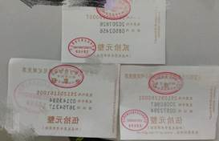
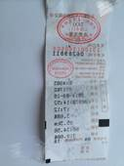
About reimbursement of taking a taxi
Such an invoice is the only way to be reimbursed.
Just like

Slide 21

About reimbursement of taking a taxi
Pay attention:
Taking a taxi in this way is not allowed to be reimbursed.

Slide 22


